Slide 1
Weekly Project Update
Laurent Bialylew
Daniil Karbukov
Xie Wenhao

Slide 2
Work done last week
01
02
03
Created UMLs
Register patient function
Book appointment function

Slide 3
Work done this week
01
02
03
04
Created and updated UMLs
Record prescription
Expanded existing UMLs with new functions
Added a prescriptions attribute for patients so their prescriptions can be recorded
Update medical history
Retrieve medical history
Function to update medical history by patient Id
Function to retrieve medical history by patient Id

Slide 4
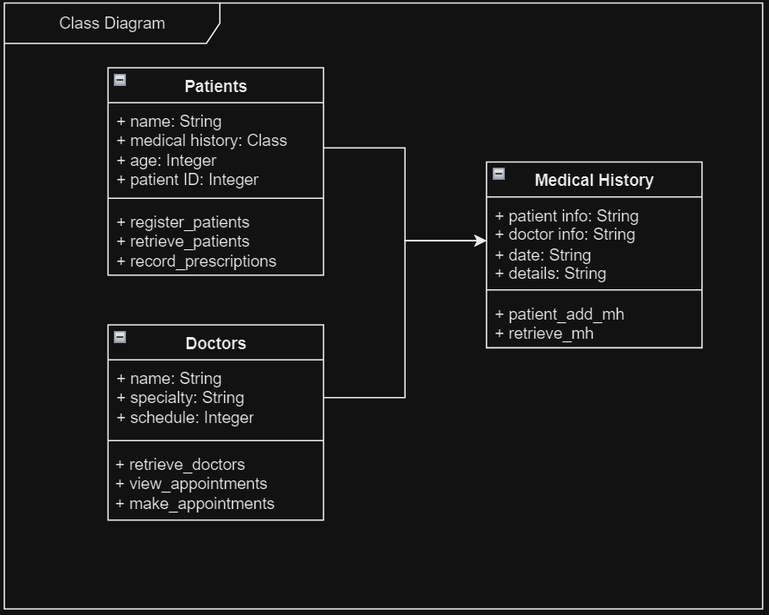
Class UML

Slide 5
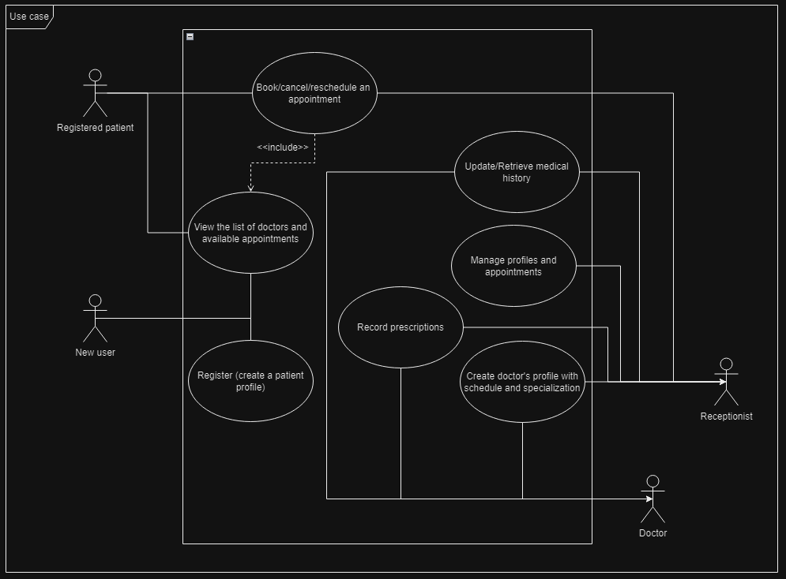
Use case UML

Slide 6
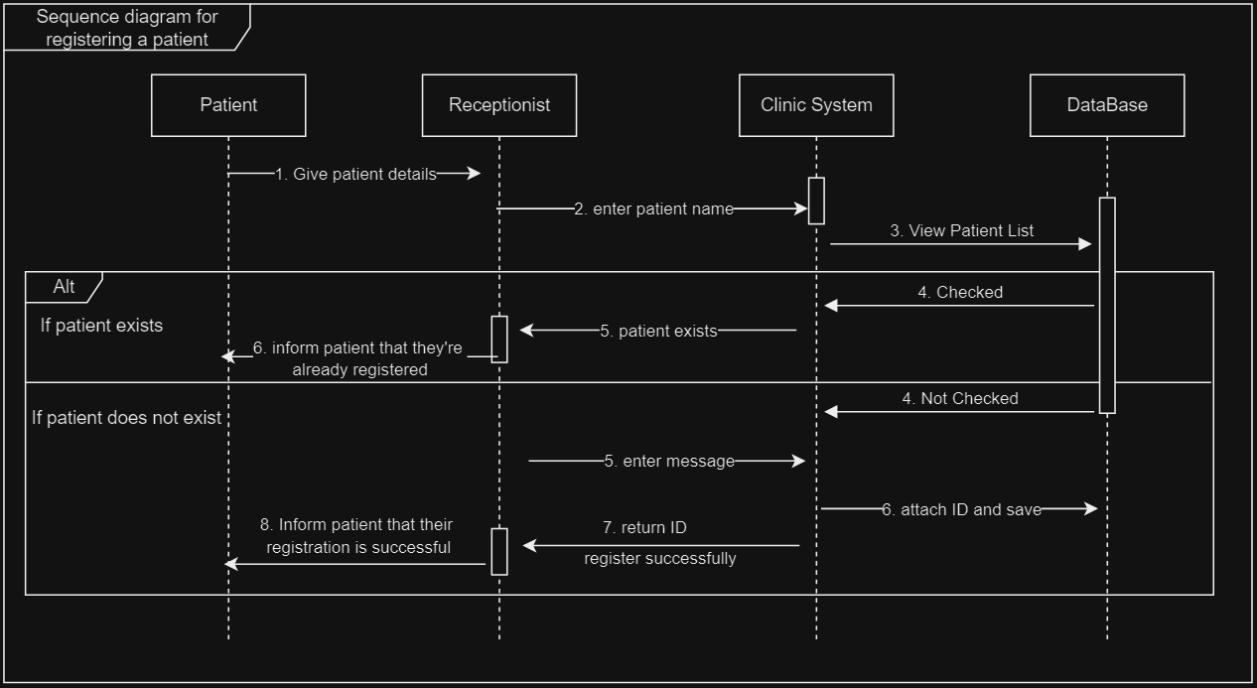
Sequence UML for registering a patient

Slide 7
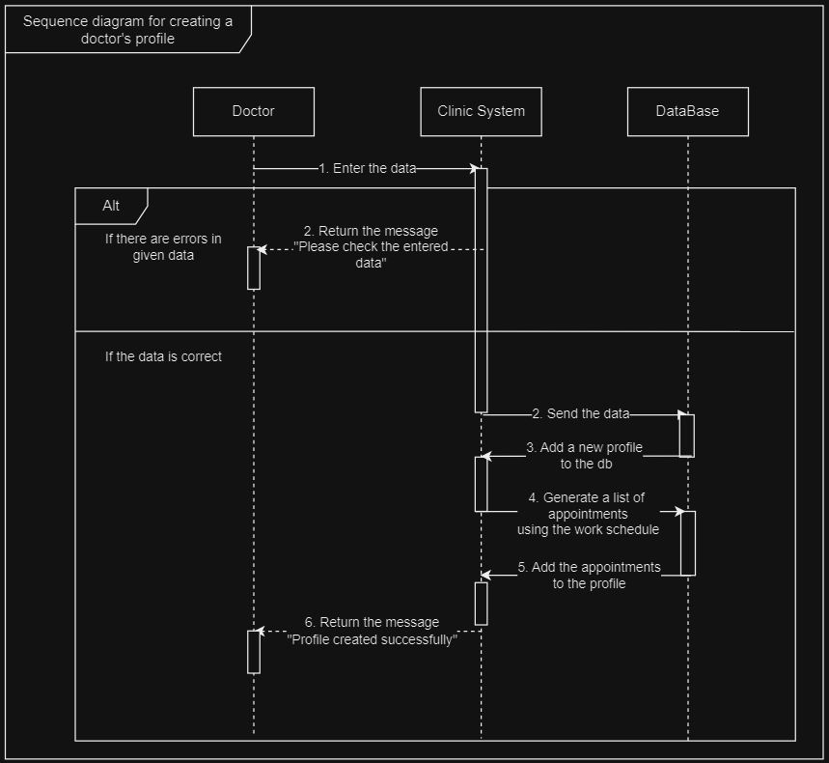
Sequence UML for creating a doctor's profile

Slide 8
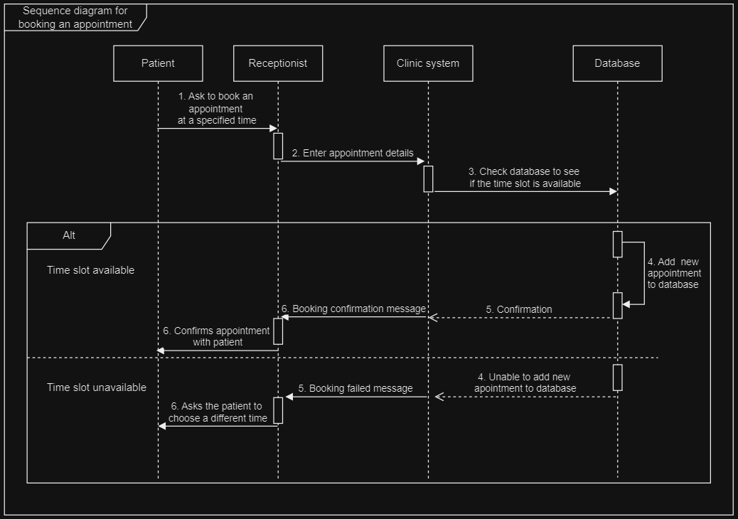
Sequence UML for booking an appointment

Slide 9
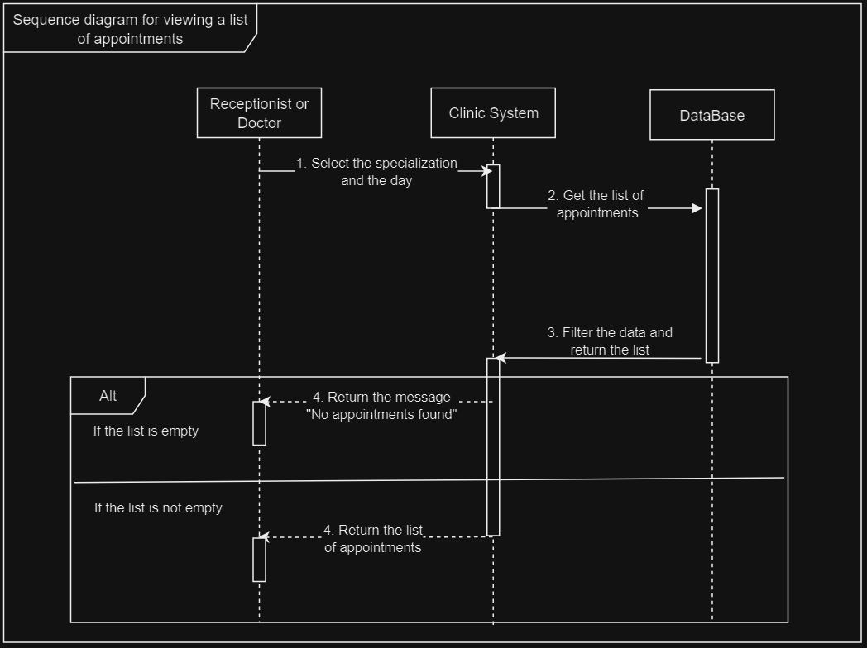
Sequence UML for viewing appointment list

Slide 10
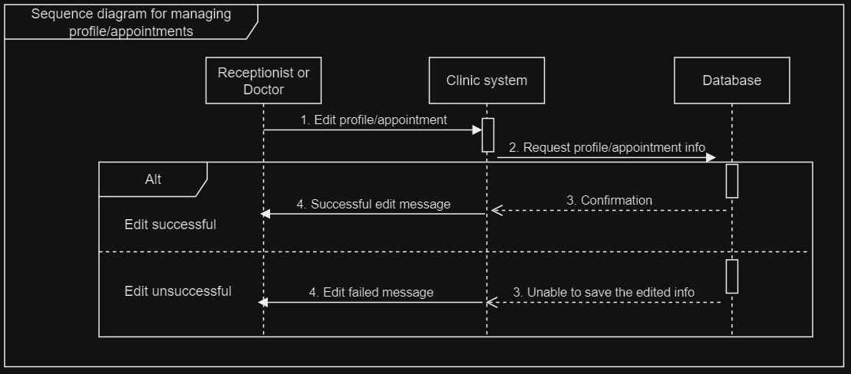
Sequence UML for managing appointments and profiles

Slide 11
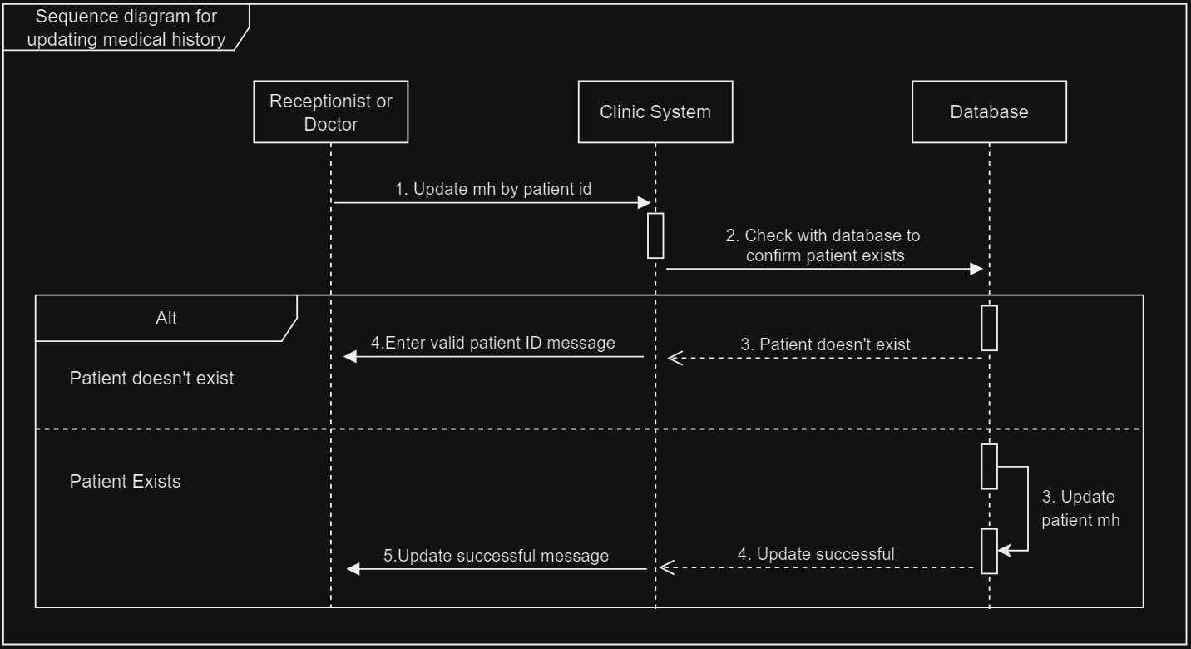
Sequence UML for updating medical history

Slide 12
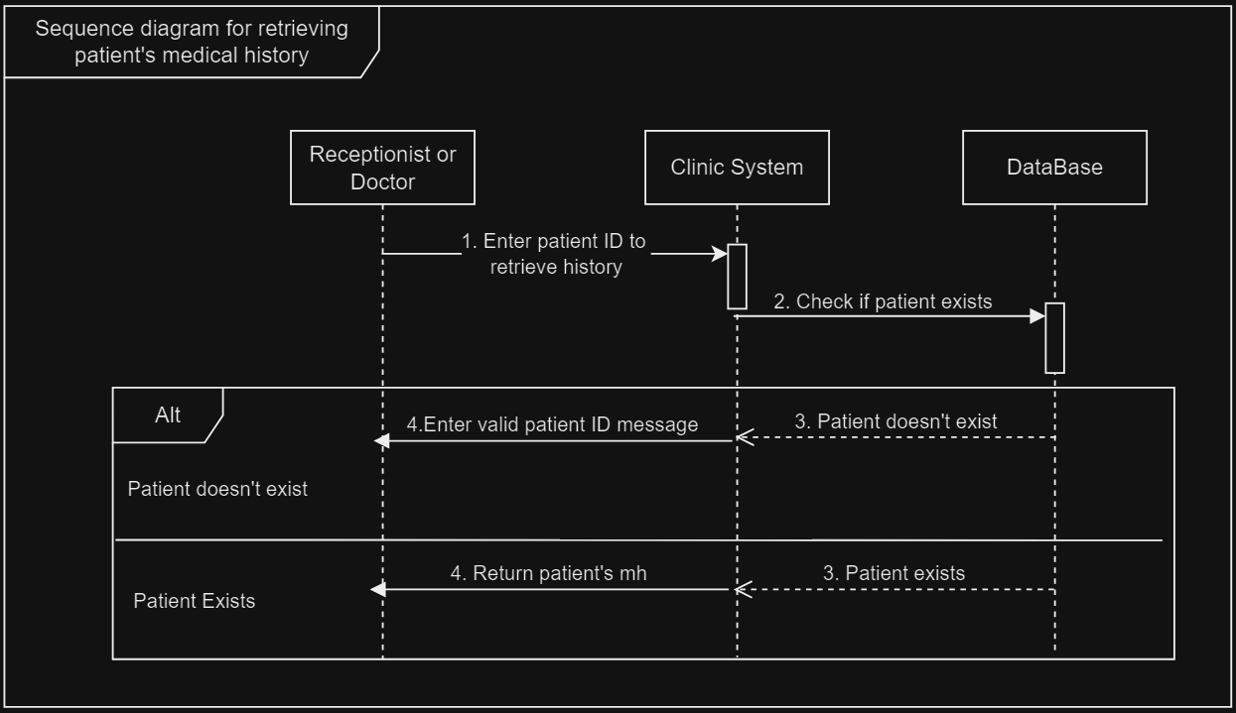
Sequence UML for retrieving medical history

Slide 13
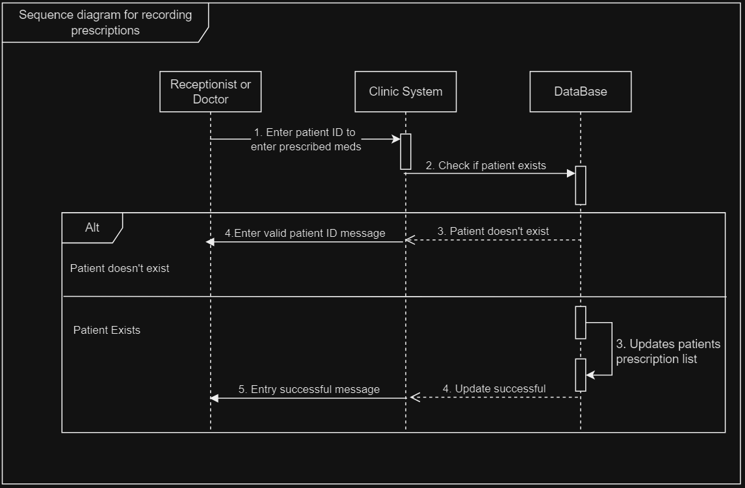
Sequence UML for recording prescriptions

